Slide 1

Predict the quality of wine
Name: Vijay kumar Tamada
Aravind reddy Kasireddy

Slide 2
Introduction:
Welcome to the presentation on predicting the quality of wine through regression analysis. From Wikipedia, Red wine is a type of [wine](https://en.wikipedia.org/wiki/Wine) made from dark-colored [grape varieties](https://en.wikipedia.org/wiki/Grape_varieties). The actual [color of the wine](https://en.wikipedia.org/wiki/Wine_color) can range from intense violet, typical of young wines, through to brick red for mature wines and brown for older red wines. The [juice](https://en.wikipedia.org/wiki/Juice) from most purple grapes is greenish-white, the red color coming from anthocyan pigments (also called [anthocyanins](https://en.wikipedia.org/wiki/Anthocyanins)) present in the skin of the grape; exceptions are the relatively uncommon [teinturier](https://en.wikipedia.org/wiki/Teinturier) varieties, which produce a red-colored juice. Much of the red-wine production process therefore involves extraction of color and flavor components from the grape skin. It is a delicacy around the world. In the following we will be exploring the data set "Red Wine Quality", from [**kaggle**](https://www.kaggle.com/uciml/red-wine-quality-cortez-et-al-2009) In this project, we delve into the intriguing world of wine quality assessment using machine learning techniques. Our focus lies on deciphering the enigmatic relationship between the chemical composition of wine and its perceived quality.
Key Points:
Problem Overview: The objective of this project is to predict the quality of wine based on its chemical attributes, primarily leveraging its alcohol content and pH level.
Methodology: We employed various regression models including Linear Regression, Decision Trees, and Random Forest to discern patterns within the dataset.
Dataset: Our analysis is based on the renowned Red Wine Quality dataset, comprising 1,599 observations of wine samples, obtained from Kaggle.

Slide 3
Background:
Wine's Diversity: Wine, derived from fermented grapes, varies widely due to grape variety, yeast strains, and production methods. It's not limited to grapes, encompassing rice and fruit wines too.
Culinary Importance: Wine enhances cuisines globally, complementing dishes from stews to haute cuisines. It's served with meals, especially dinner, and its acidity balances savory or sweet flavors in sauces and braising.
Red Wine Complexity: Made from dark grapes, red wine's hues span from violet to brown. Extracting color and flavor from grape skins defines much of its production process, contributing to its global allure.
Wine Tasting: Evolving from ancient practices, wine tasting has a formalized methodology. Professionals use specialized terminology to describe flavors and aromas, though scientific studies highlight the inconsistency in wine identification among experts and consumers.
Cultural Significance: Wine tasting is not just analytical but also a cultural experience, enriching personal appreciation and often accompanying social events and festivals worldwide.

Slide 4
Business Questions
After encountering a dataset aimed at predicting the quality of red wine using numerical predictors, I gained insights into its background and details, despite not being a frequent drinker myself. This piqued my interest in exploring the dataset further, prompting questions about applying Supervised Machine Learning techniques, particularly Regression and Classification models, to analyze it. I pondered whether the numerical predictors in the dataset would align with the models I've studied. Additionally, I questioned how the absence of categorical predictors might impact model performance, considering some models are reputedly optimized for categorical data. Furthermore, I wondered if the widely acclaimed Random Forest method's accuracy and robustness would hold true for the Kaggle dataset I stumbled upon. Lastly, I sought to identify the most significant predictors consistently favored by interpretable models across various analyses.

Slide 5
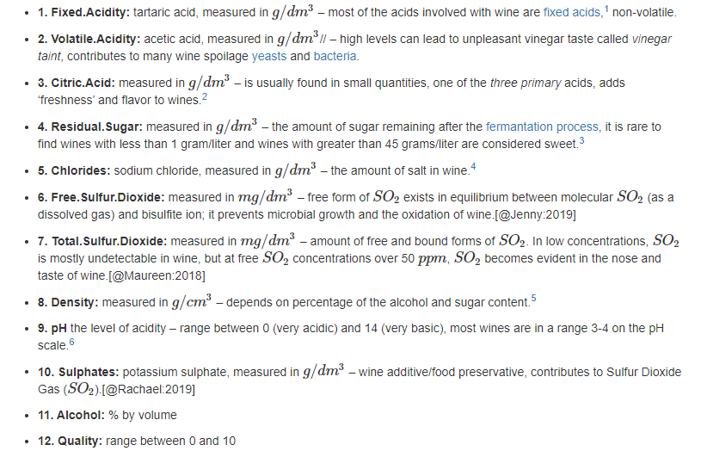
Data description
The data set we chose to analyze is the Red Wine quality data set from the Wine quality data set. It focuses on various characteristics of red wine, such as acidity levels, sugar content, and pH levels, along with a quality rating(from professional tasters). The data set consists of 1599 records. Meaning of the variables (based on physicochemical tests) can see below:

Slide 6
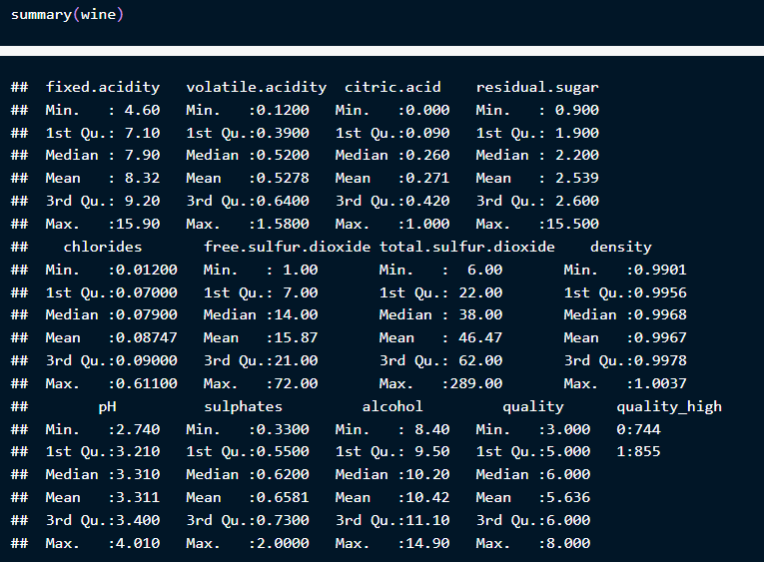
EDA and Data Visualization
Observation from the Summary
Residual Sugar: mean is 2.5g/dm3, but we have a wine that’s an outlier here with 15.5g/dm3
Free Sulfur Dioxide: mean is 15.8mg/dm3, max is 72 which is quite high because at 75%
we have 21ppm
pH: min is 2.7, mean is 3.3 and max is 4.01
. We can conclude that there is no basic wines in the data set, as there are no high pH wines.
Alcohol: lightest wine is 8.4% , where strongest is at 14.9%.
Quality: min value is 3, mean is 5.6 and the max is 8.

Slide 7
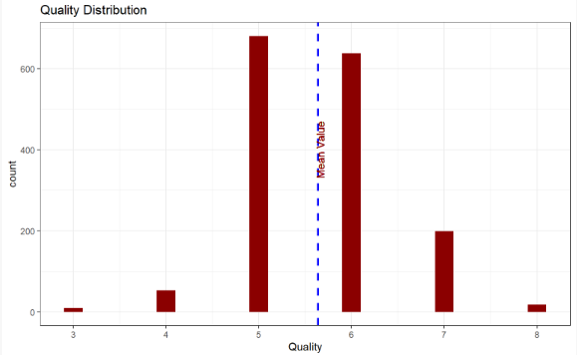
Quality target feature distribution
As we can see, vast majority of the quality of wine is around 5 and 6, which is 82.4890557%. This also means that our data set is unbalanced. This makes it harder for us to pin point factor that could affect Quality in any possible way.

Slide 8
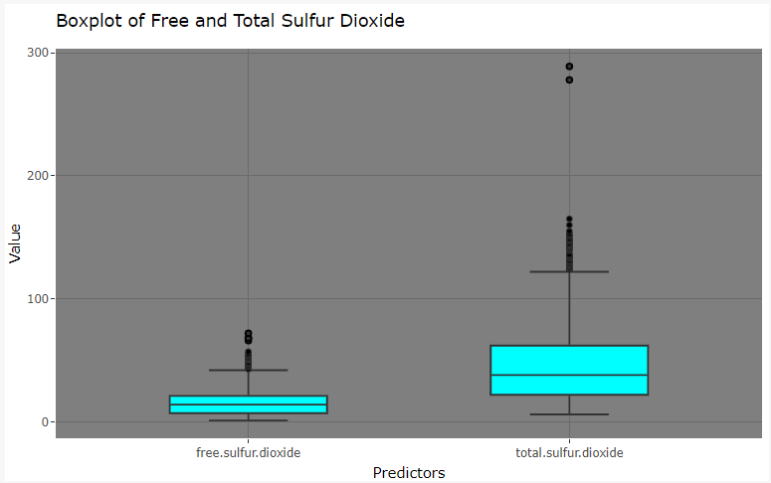
Boxplot of Variables
The presence of numerous outliers among most predictors suggests caution against their removal, as doing so may lead to significant information loss. Notably, predictors such as alcohol and citric acid exhibit relatively normal and consistent distributions, with few outliers and median values positioned centrally within their respective boxplots. This suggests that these predictors may offer reliable and valuable insights into the dataset without the need for extensive data manipulation.

Slide 9
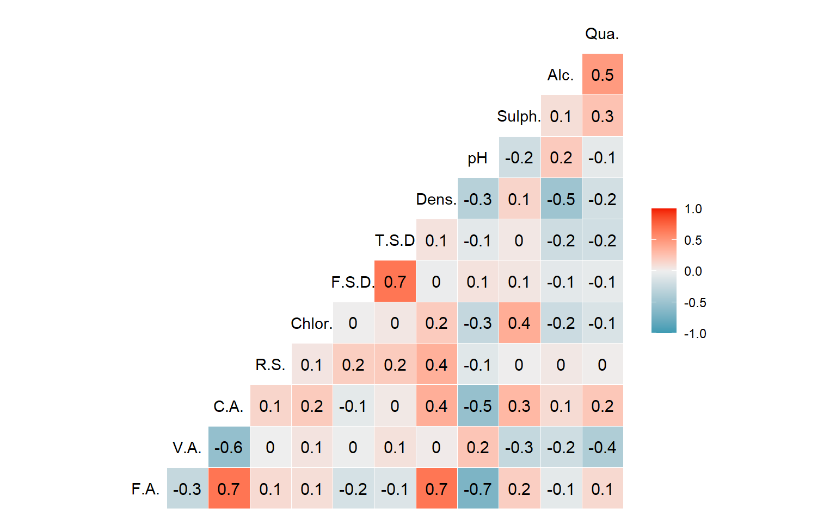
Checking Correlations between Predictors
Factors related to Quality:
Three key positive relationships between Quality and Citric.Acid, Alcohol and Sulphates.
Three key negative relationships between Quality and pH, Density and Volatile.Acidity.
Other variables don’t have any significant relationships with Quality.
Other interesting factors:
Alcohol has a weak positive correlation with pH value.
Alcohol has a strong negative correlation with Density.
Density and Citric.Acid have a strong positive correlation with Fixed.Acidity.
pH value has a negative correlation with Sulphates, Citric.Acid, Fixed.Acidity and Density

Slide 10
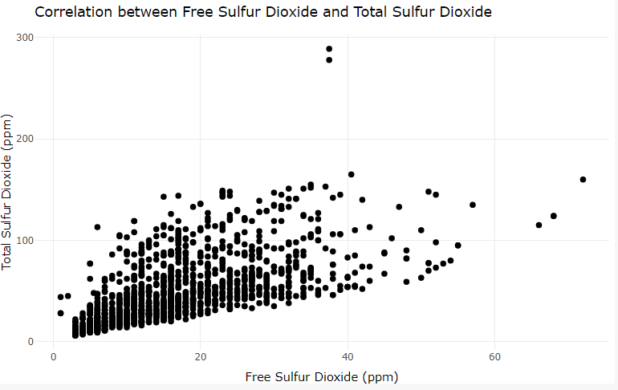
Relationship b/w Free Sulfur Dioxide and Total Sulfur Dioxide
While a discernible trend line suggests a positive correlation between the two variables, the scattered spread of data points indicates considerable randomness. As such, despite potential linear relationships, it appears unnecessary to prioritize special feature engineering for these variables.

Slide 11
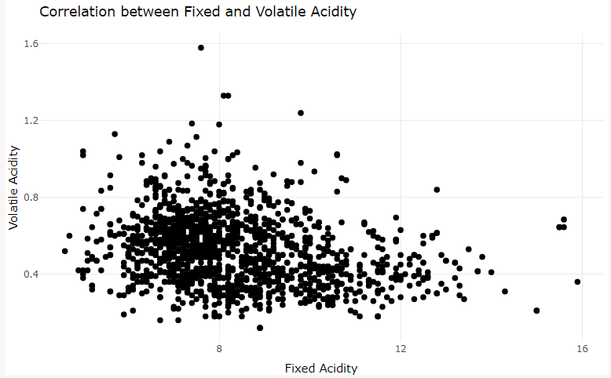
Fixed Acidity and Volatile Acidity
While the scatter plot reveals a strong correlation between the variables, the absence of a discernible pattern suggests that neither variable reliably predicts the other with its own linearity. Consequently, this combination of variables can be utilized without concern, as their mutual relationship appears stable and predictable.

Slide 12
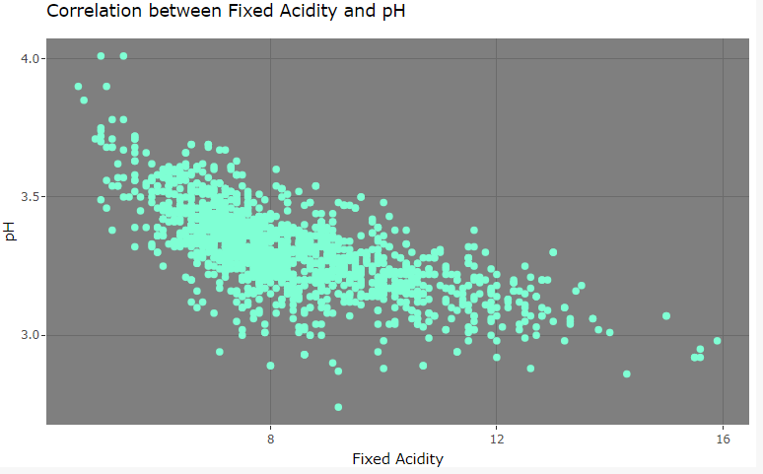
Relationship b/w Fixed Acidity and pH
Although a trend line could be approximated from the top-left to the bottom-right of the chart, the scattered distribution of data points diminishes the validity of such estimation. Consequently, the lack of discernible linearity between these two variables suggests that they do not exhibit a clear linear relationship.

Slide 13
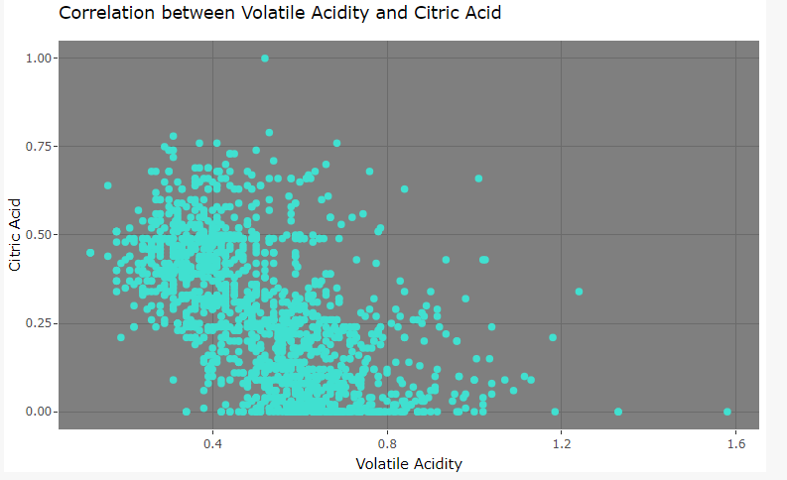
Volatile Acidity and Citric Acid
The spread of data points throughout the bottom-left of the chart indicates a lack of clear linearity between these two variables, similar to previous observations. Without a discernible pattern indicating a linear relationship, it appears that these variables do not exhibit a strong correlation with each other.

Slide 14
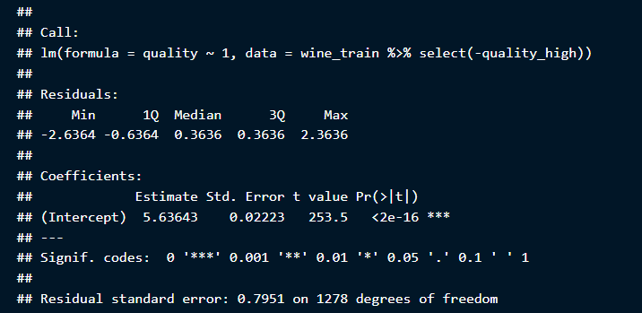
Linear Regression Model Model with No Predictor

Slide 15
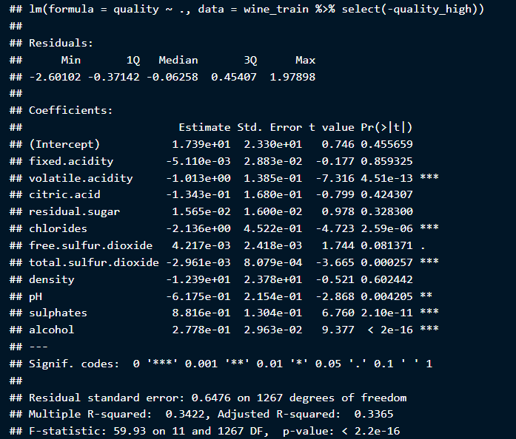
Model using All Predictors (as baseline)
Interpretations from this simple model indicate:
Variables such as volatile acidity, chlorides, total sulfur dioxide, sulphates, and alcohol exhibit high significance based on their p-values.
Free sulfur dioxide and pH, while not as highly significant, still hold significance in the model.
The adjusted R-squared value, at 35.61%, suggests a relatively low level of explanatory power, indicating room for improvement by eliminating unnecessary predictors.
Currently, no variables demonstrate perfect separation or singular predictive power for the target variable, as evidenced by p-values that are not extremely insignificant or close to 1. Thus, solely relying on machine learning for prediction based on these variables would not be advisable.

Slide 16
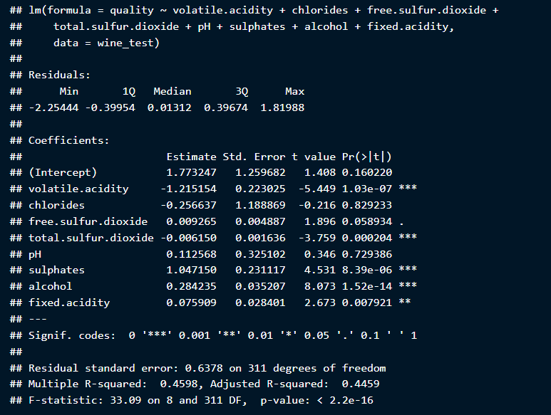
Model using All Predictors (as baseline)
Prediction using Test Data:
Given that our model meets most assumptions, rather than predicting the test data separately, we can leverage the predictors from the best model identified during our comparisons and assumption verification process. Surprisingly, the model's performance on the test data was marginally better than on the training data, with an explained variance of approximately 44.59% for the quality variable.
Conclusions:
Our top-performing simple linear regression model, derived through both manual and stepwise approaches, includes predictors such as volatile acidity, chlorides, free sulfur dioxide, total sulfur dioxide, pH, sulphates, alcohol, and fixed acidity. While the adjusted R-squared for the training data stands at 33.73%, it notably improves to 44.59% on the test data. Although the model falls short of meeting all assumptions, failing only one, further exploration is warranted to determine if objectively superior models exist.

Slide 17
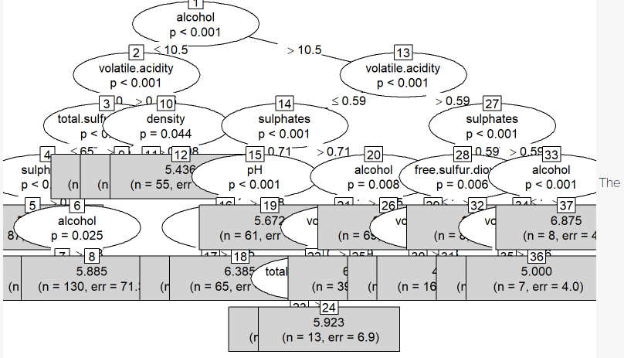
Classification Model: Decision Tree
Using it as a Regression Model
Notes:
information is very crowded! This model and plot is only using the default parameters of a decision tree, so we can tune it out a little better if we needed it to. But then again, looking at the leafs/terminal nodes, which are the nodes that are not branching to another decision anymore (the greyed out boxes at relatively bottom of the tree), we can see that there are some numbers predicted, while there is a possible error in there also. Just looking at one leaf node at quite the middle of the tree, it has the predicted value of 5.672, with a possible error of 37.4, well that would not make any sense, wouldn’t it? Our quality rating is only from 0-10 anyway. Similarly, there are a lot of leaf nodes showing similar, too extreme errors, that I don’t think pruning this regression decision tree would help it too much.
Therefore, I think it would be best if we go back to use the Decision Tree as a classification model, and use the quality_high as the target variable instead.

Slide 18
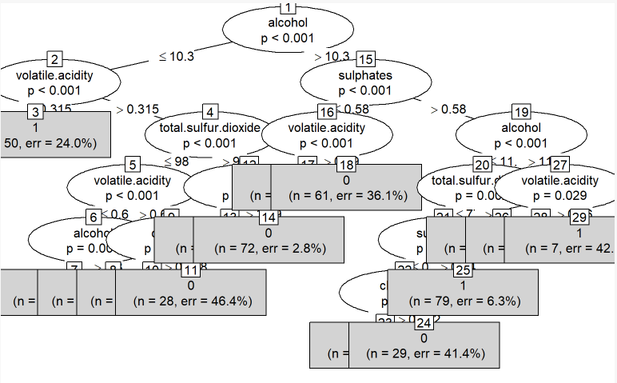
Classification Model: Decision Tree
Using it as a Classification Model
Notes:
I was tempted to use a plot type=simple like before, but seeing that the result are still overlapped with eachother, I prefer to use without it instead, since we can pretty much classify each leaf node using a default threshold of 0.5, to use its prediction. It should be noted that the leaf count is 15 for this one.
As we can see from the tree, some decisions are quite polarizing and leave a little error to be considered, for example Node 14 (the probability is very close to being 0) or Node 28 (it’s very close to being 1), while others are not so polarized, even few nodes are a bit close to our threshold of 0.5 (like Node 11 and Node 29) that it might be the nodes that is causing most of the errors (false negatives or false positives) later on.
Predictors that are highly relevant/significant (excluding duplicates and if the branches are all classifying to only one class): - alcohol - volatile.acidity - chlorides - sulphates - total.sulfur.dioxide

Slide 19
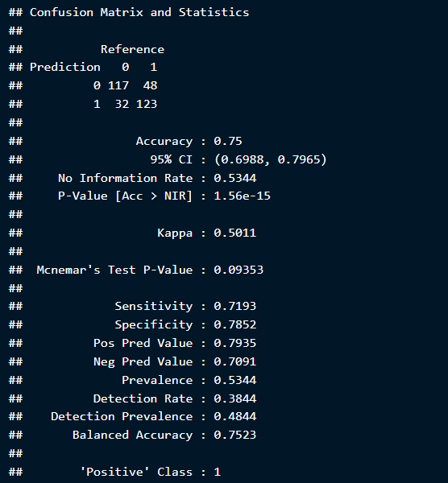
Model Evaluation
Using Default Parameters: DT
Notes:
Accuracy: 75.00%
Precision / Pos Pred Value: 79.35%
One of the good ones we’ve had compared to other models, although since the leafs are too many, this could be less readable.

Slide 20
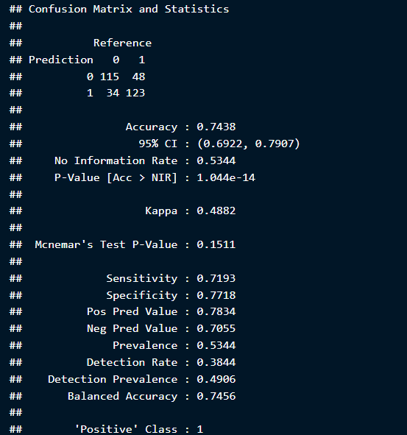
Model Evaluation
Using Customized Parameters: DT
Accuracy: 74.38%
Precision / Positive Predictive Value: 78.34%
Although slightly lower than the default parameters, this configuration offers improved readability.
Conclusions:
Comparing our Decision Tree model with default parameters to a pruned alternative, the former demonstrates superior metrics. The predictors - alcohol, volatile acidity, chlorides, sulphates, and total sulfur dioxide - contribute to its effectiveness. Despite this, we've developed a pruned model with customized parameters for enhanced readability, featuring fewer leaf nodes. The accuracy of our best Decision Tree model stands at 75.00%, with a precision of 79.35%.
Notes:
Accuracy: 75.00%
Precision / Pos Pred Value: 79.35%
One of the good ones we’ve had compared to other models, although since the leafs are too many, this could be less readable.

Slide 21
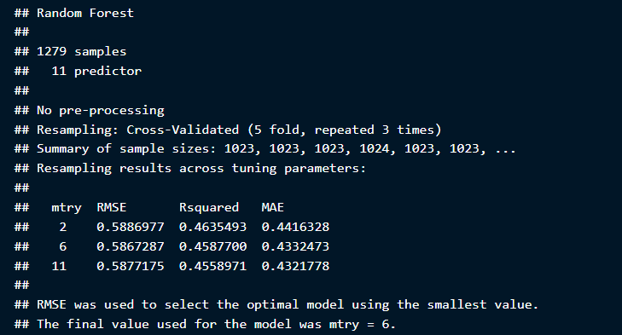
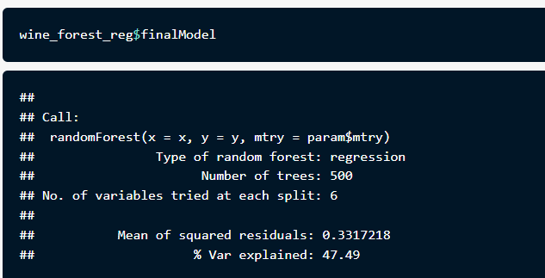
Model Evaluation RF Model
Regression Model
In the context of Random Forest modeling, "mtry" denotes the number of predictors utilized in fitting a new Decision Tree model. After multiple iterations, our analysis reveals that the algorithm selected an "mtry" value of 6, as it corresponds to the lowest Root Mean Square Error (RMSE), representing an estimate of model error.
Random Forest incorporates its own cross-validation technique known as Out-Of-Bag (OOB) Error. This approach involves randomly segregating data and evaluating the model's performance on unseen data, akin to manual validation procedures. Consequently, the use of traditional cross-validation or train-test splitting techniques becomes unnecessary when employing Random Forest.
Despite Random Forest's model accuracy being assessed at 47.49%, which may seem relatively low, it represents an improvement compared to our initial linear regression model. This improvement, albeit modest, underscores the efficacy of Random Forest in capturing complex relationships within the data.
Notes:
Accuracy: 75.00%
Precision / Pos Pred Value: 79.35%
One of the good ones we’ve had compared to other models, although since the leafs are too many, this could be less readable.

Slide 22
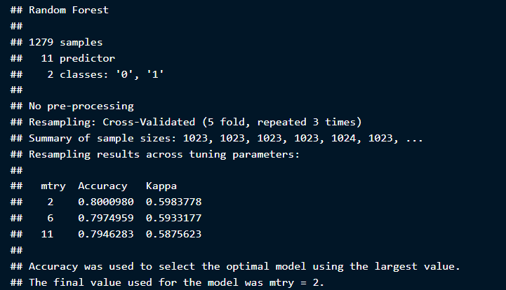
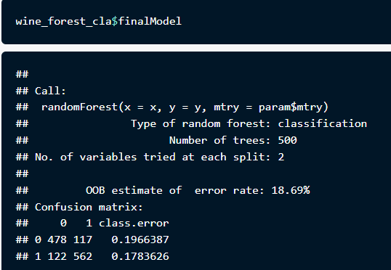
Model Evaluation RF Model
Classification Model
The algorithm's repeated iterations reveal that the optimal "mtry" value is 2, leading to the random selection of 2 predictors at each node of the Decision Tree until tree construction is finished. Additionally, as discussed earlier, Random Forest utilizes the Out-Of-Bag (OOB) technique to evaluate model performance with randomly sampled observations treated as unseen data. Notably, this evaluation unveils a remarkably low error rate of 18.69%, translating to an impressive accuracy of 81.31%. This standout performance represents the highest accuracy observed among all models examined thus far.
Notes:
Accuracy: 75.00%
Precision / Pos Pred Value: 79.35%
One of the good ones we’ve had compared to other models, although since the leafs are too many, this could be less readable.

Slide 23
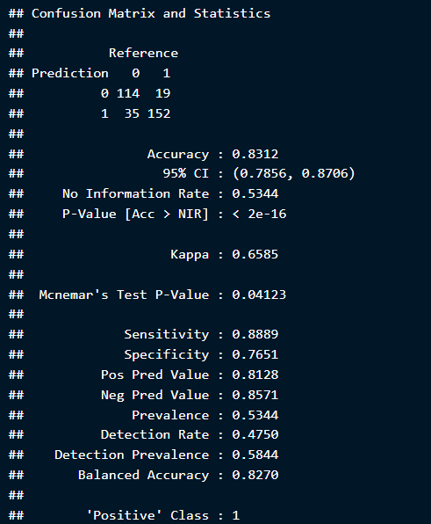
Model Evaluation RF Model
With an impressive accuracy of 83.12% and a precision of 81.28%, the Random Forest model surpasses previous performance benchmarks, marking the first instance where any prediction models, be it regression or classification, achieve an accuracy rate exceeding 80%. This unequivocally positions Random Forest as one of the most reliable models for predicting target variables. In regression, the model demonstrates a capability to explain 47.49% of the target variable, leaving 52.51% attributed to predictors outside those utilized. However, in classification, its accuracy and precision metrics objectively outshine all other models, solidifying Random Forest as the top performer across both domains.
Notes:
Accuracy: 75.00%
Precision / Pos Pred Value: 79.35%
One of the good ones we’ve had compared to other models, although since the leafs are too many, this could be less readable.

Slide 24
Comparing Models and Conclusions
Analysis Result:
The exploration of the data we focused on in the Red Wine Quality data set show that there are multiple factors impacting the Quality of the wine, positively and negatively. WIth this particular analysis we saw that the clear outlier here is that high percentage of Alcohol correlates to high-quality wines. Following, it seems that high-quality wines have lower Volatile.Acidity which matches with our results. Change in Residual.Sugar had no effect on Quality and it didn’t seem to impact any other variable. As we saw the Quality levels of our wines are unbalanced which probably severely impacted our final results and we could say we were limited by it in grand scheme of things. This meant that more than 80%
of the wine tested in this data set did not satisfy our Personal.Quality test. Also, as we saw at the beginning Free.Sulfur.Dioxide, Total.Sulfur.Dioxide and Density weren’t balanced with the rest of the data, so this part of the data would need another further treatment. We can conclude that the levels of wine quality are based on personal taste of experts, but there are also factors like year of production, brew time, location, wine brand, etc. that could have an important impact to our data that we didn’t have access too.
Performance of Regression Models
The Linear Regression Model, derived through both manual and stepwise approaches, yielded an adjusted R-squared metric of 44.59%. However, it failed one of the four required assumptions, indicating caution regarding its use due to heteroscedasticity.
The Decision Tree Model exhibited errors in leaf nodes, making it unfit for estimating the numerical quality rating of red wine.
The Random Forest Model, an ensemble of Decision Trees, showcased improvement with a 47.49% score in explaining quality. While resource usage might not be balanced for larger datasets or urgent inquiries, it stands out as one of the best regression models explored.
Classification Models Performnce
The Decision Tree Model, known for its interpretability, achieved 75.00% accuracy and 79.35% precision. After some parameter tuning, a simpler alternative emerged, albeit with a slight sacrifice in accuracy and precision.
The Random Forest Model outperformed all classification methods with 83.12% accuracy and 81.28% precision. However, its computational demands may not be suitable for urgent cases or resource-constrained scenarios.
Overall Conclusions
- Random Forest emerges as a robust machine learning method, offering a balance between accuracy, precision, and resource utilization. Across various model comparisons, key predictors like Alcohol, Volatile Acidity, Sulphates, and Total Sulfur Dioxides emerged as crucial factors influencing red wine quality.
Notes:
Accuracy: 75.00%
Precision / Pos Pred Value: 79.35%
One of the good ones we’ve had compared to other models, although since the leafs are too many, this could be less readable.

Slide 25
References
Dua and Graff (2017) and Malik (2019) and Griesemer (2019) and Hadley Wickham (2016) and Woods (2017) and Rashid (2015)
Dua, Dheeru, and Casey Graff. 2017. “UCI Machine Learning Repository.” University of California, Irvine, School of Information; Computer Sciences. http://archive.ics.uci.edu/ml.
Griesemer, Jeff. 2019. “Using r for Exploratory Data Analysis (EDA) — Analyzing Golf Stats.” https://towardsdatascience.com/using-r-for-exploratory-data-analysis-eda-analyzing-golf-stats-812b5feb077a.
Hadley Wickham, Garrett Grolemund. 2016. “R for Data Science: Import, Tidy, Transform, Visualize, and Model Data. O’reilly Media.” https://books.google.si/books?id=I6y3DQAAQBAJ.
Link, Rachael. 2019. “What Are Sulfites in Wine? Everything You Need to Know.” https://www.healthline.com/nutrition/sulfites-in-wine.
Malik, Samartha. 2019. “Data Analysis and Visualisations Using r.” https://towardsdatascience.com/data-analysis-and-visualisations-using-r-955a7e90f7dd.
Moroney, Maureen. 2018. “Total Sulfur Dioxide - Why It Matters, Too!” https://www.extension.iastate.edu/wine/total-sulfur-dioxide-why-it-matters-too.
Rashid, Miadad. 2015. “Wine Quality Exploration.” http://rstudio-pubs-static.s3.amazonaws.com/80458_5000e31f84df449099a872ccf40747b7.html.
Savits, Jenny. 2019. “Sulfur Dioxide Measurement and Overestimation in Red Wine.” https://www.extension.iastate.edu/wine/sulfur-dioxide-measurement-and-overestimation-red-wine.
Woods, David. 2017. “R Correlation Tutorial.” https://www.datacamp.com/community/blog/r-correlation-tutorial.

Slide 26

Thank You

